Slide 1
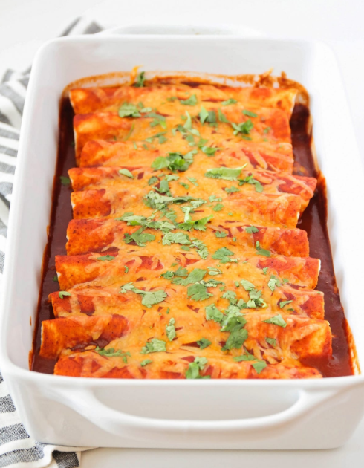
The gator plate-r Beef enchiladas

Slide 2
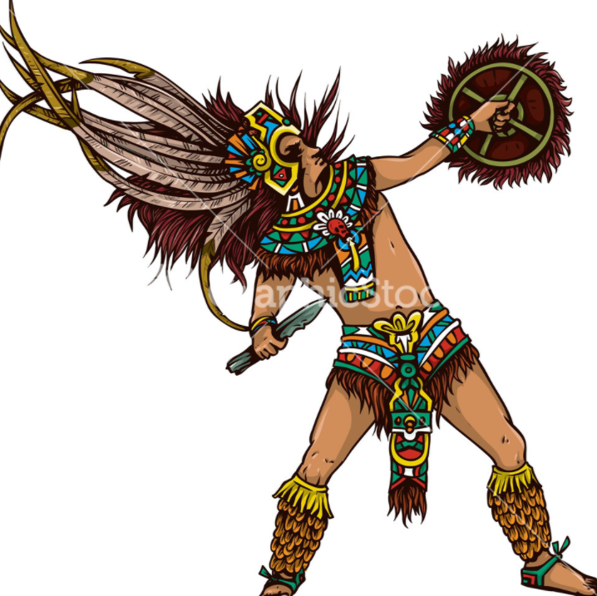
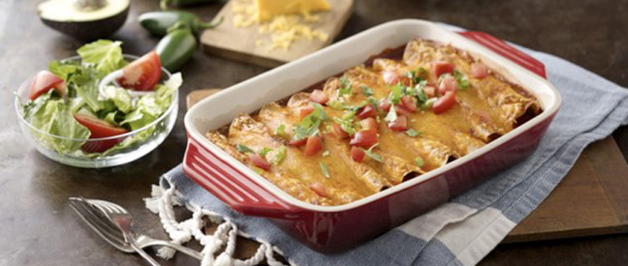
What are Enchiladas?
Enchiladas are similar to a burrito. They consist of a corn or flour tortilla, stuffed with fillings and wrapped tightly. They’re covered in sauce and cheese and served with a variety of side dishes – it’s one of the few Mexican dishes you enjoy with a knife and fork. Enchiladas likely started as a street food and evolved over time – the earliest known form of the dish was simply a rolled tortilla dipped in chilli sauce. The word itself is a compound of two Nahuatl words, ‘chilli’ and ‘flute’.
Nahuatl has been spoken in Central Mexico since the seventh century. It was the language of the mighty Aztec civilization. We learn about the Aztecs in grade 8 Social Studies.

Slide 3
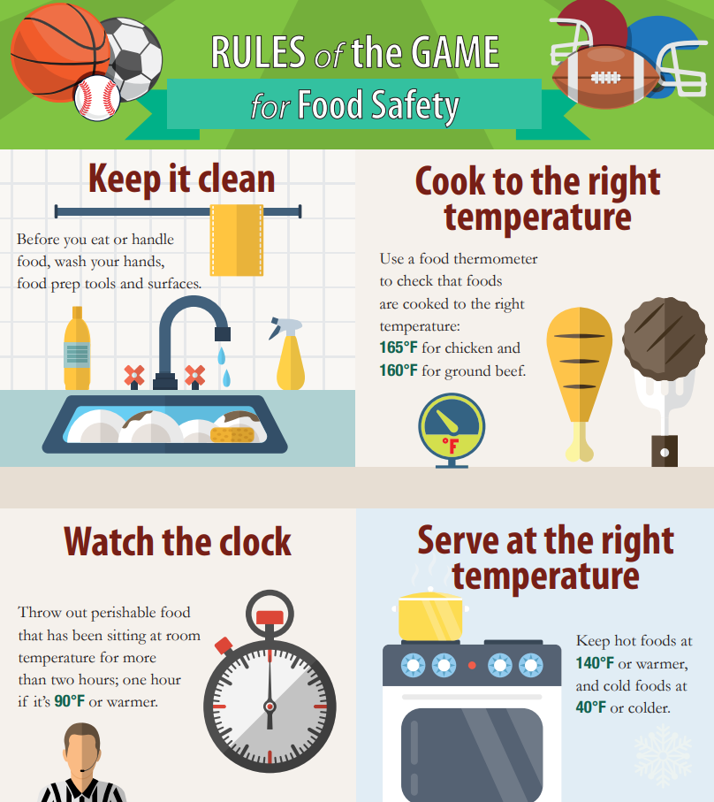
Food and Kitchen Safety
Make sure you have permission from your parents before you cook!
Be careful when using the stove, oven, or cutting ingredients.
Use separate cutting boards, plates, and knives when handling raw meat and produce. Do not cross contaminate!

Slide 4
Recipe Ingredients
Beef Enchiladas:
1 tablespoon cooking oil
1/2 cup finely diced yellow onion
2 garlic cloves
1 lb. lean ground beef
1 package low sodium taco seasoning
juice of 1 lime
8–10 whole wheat & corn tortillas
12 oz. red enchilada sauce
1 1/2 cup mexican cheese
optional garnish: cilantro, avocado, diced tomato, pickled onions or sliced jalapeno, sour cream
Vegetarian Enchiladas:
1 tablespoon cooking oil
1/2 cup finely diced yellow onion
2 garlic cloves
1 lb. plant based ground round
1 package low sodium taco seasoning
juice of 1 lime
8–10 whole wheat & corn tortillas
12 oz. red enchilada sauce
1 1/2 cup Mexican cheese
optional garnish: cilantro, avocado, diced tomato, pickled onions or sliced jalapeno, sour cream

Slide 5
Instructions
1. Preheat oven to 350 degrees F.
2. Heat a large skillet to medium-high heat
3. Add oil to the skillet, then add onions. Saute until translucent, about 3 minutes.
4. Add in chopped garlic cloves, saute for 30 seconds, then add in ground beef.
5. Saute ground beef for 5-7 minutes, breaking up the meat with a wooden spoon. Once browned, drain fat with a spoon.
Add in taco seasoning package and follow directions on the back of the package. At this time also squeeze in lime juice.
Add ¼ cup of enchilada sauce to the bottom of a casserole dish. Spread across the entire bottom of the dish.
Assemble enchiladas: Lay the tortilla flat and add 1/3 cup of meat mixture to the center and top with a little cheese. Fold and roll the filled tortilla, then place it seam side down in casserole dish. Repeat process until all the tortillas and meat are used up. Pour the remaining enchilada sauce over the rolled tortillas. Then top with remaining cheese.
Place the dish in the oven and bake for 15 minutes uncovered. Remove when cheese is melted.
Serve as is, or garnish with fresh cilantro, avocado, diced tomatoes, sliced jalapenos
A dollop of sour cream goes well with enchiladas as well.

Slide 6
Enjoy your enchiladas!

